Slide 1


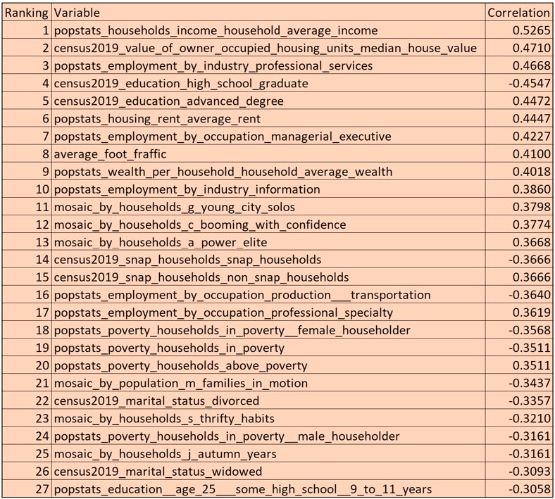
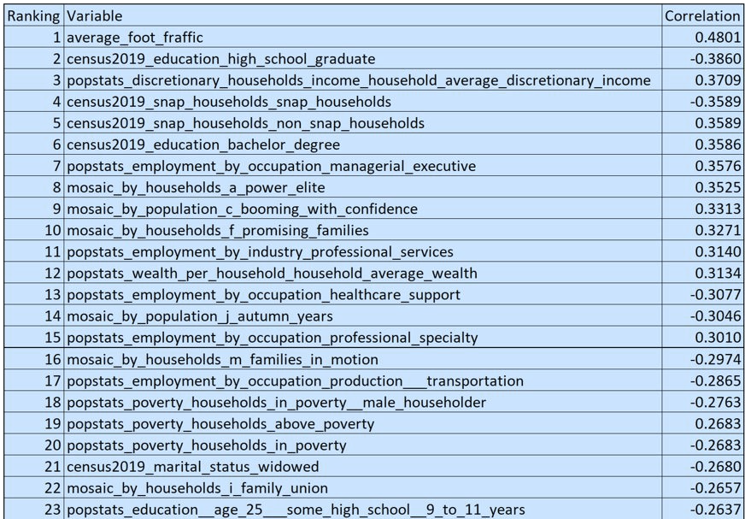
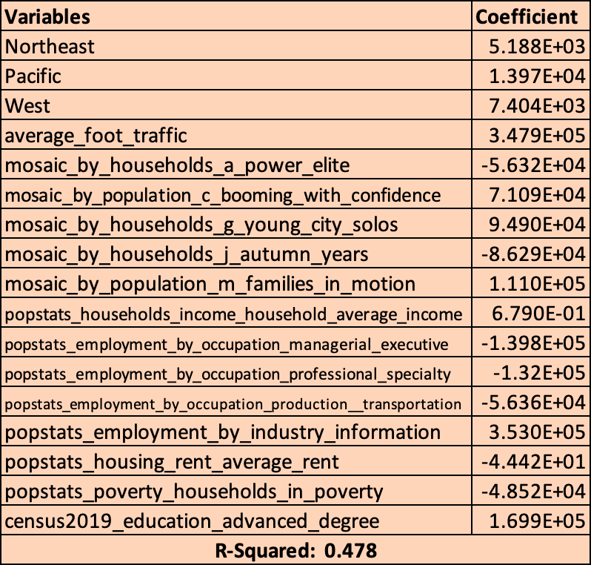
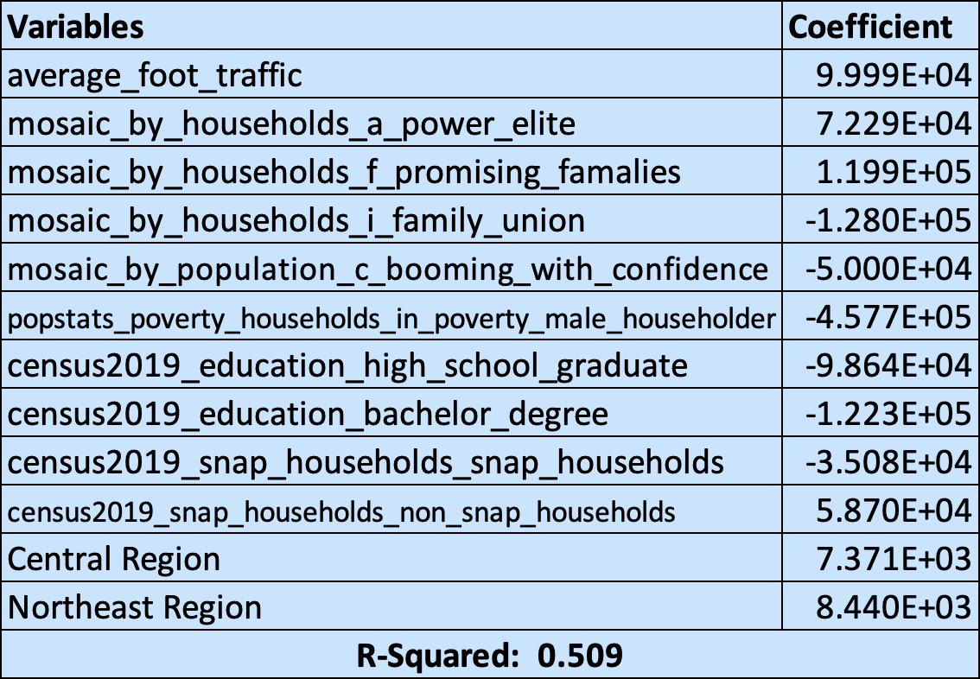
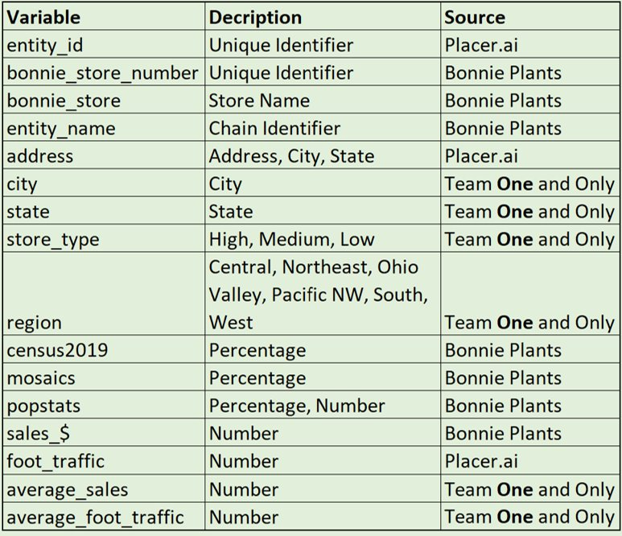
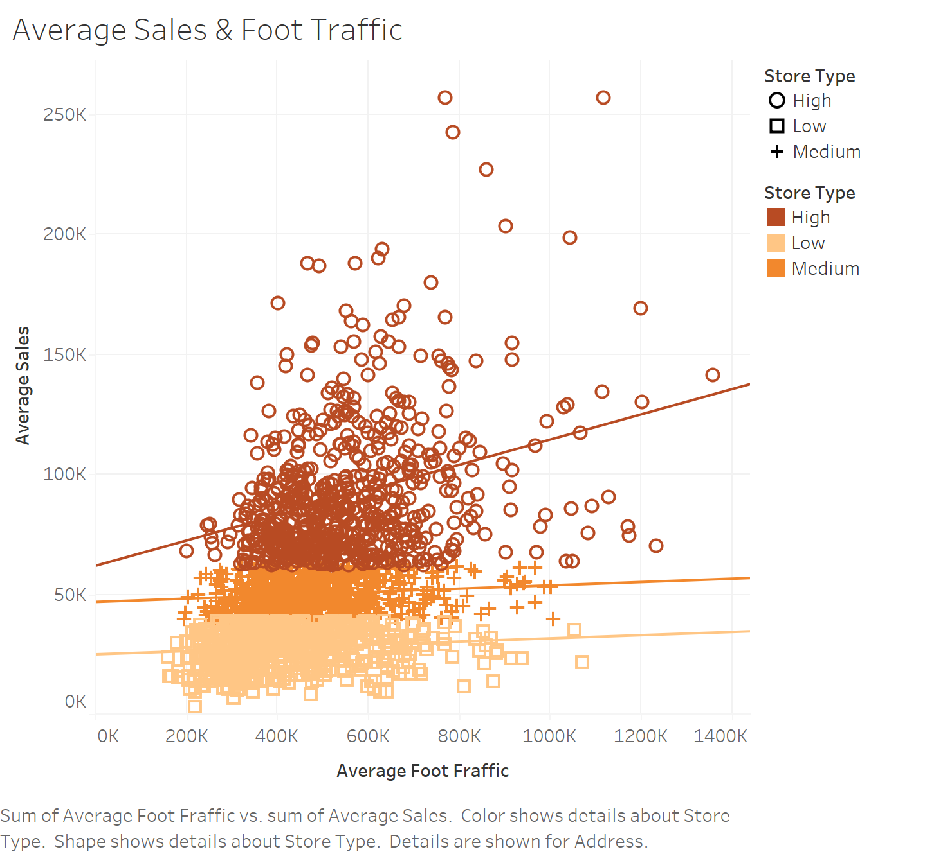
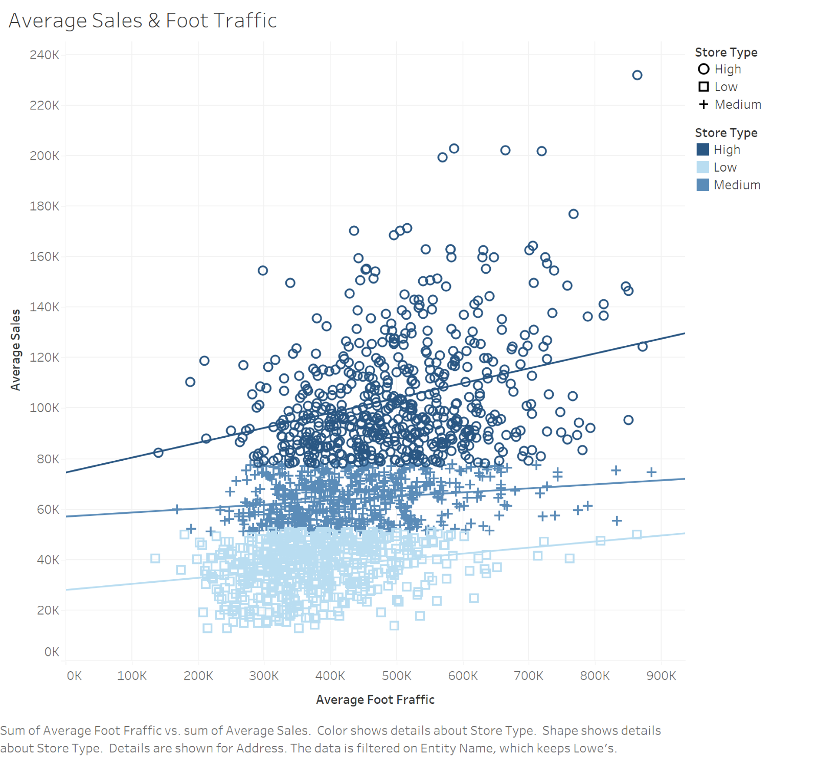
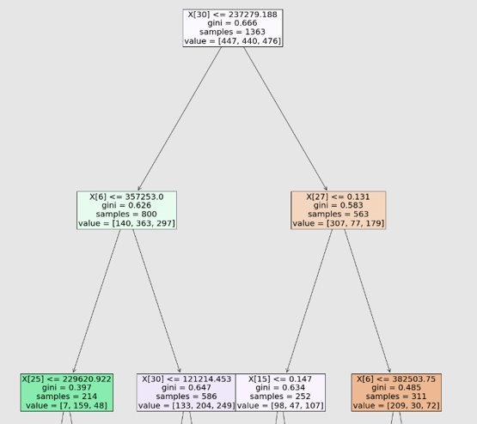
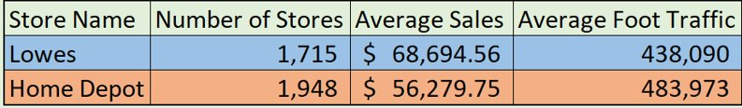
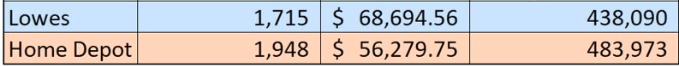
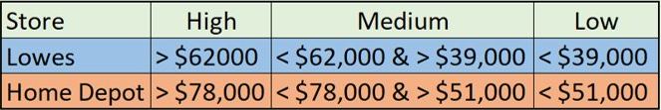
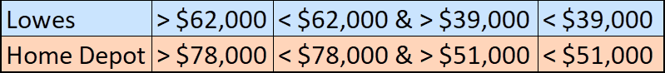
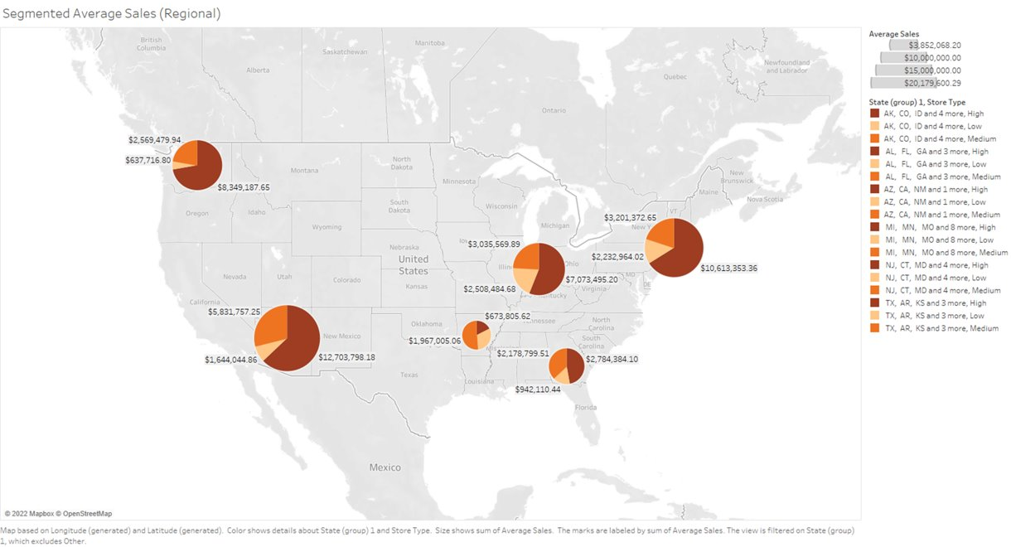
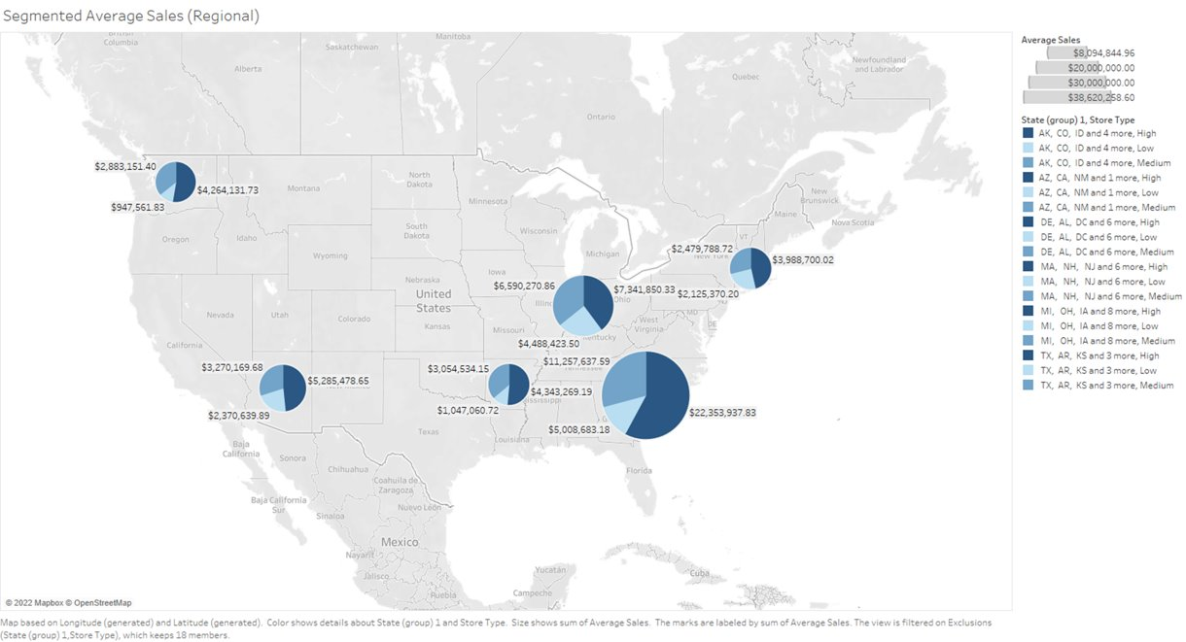
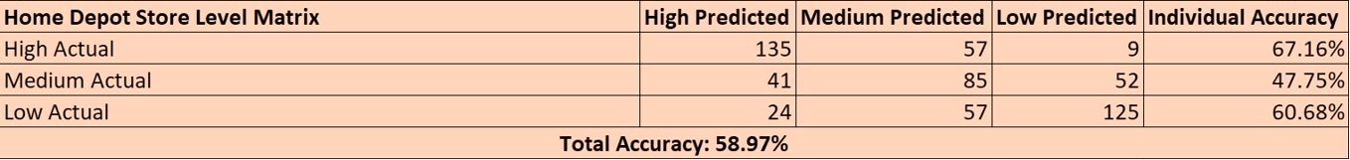
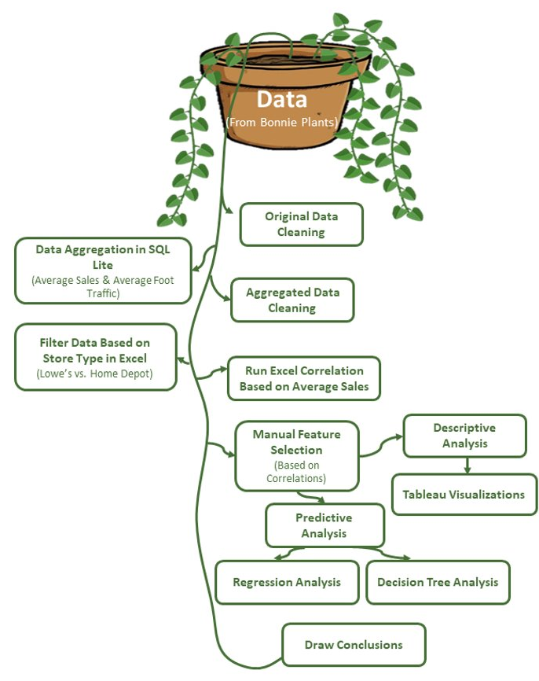
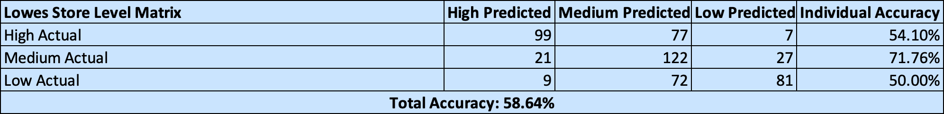
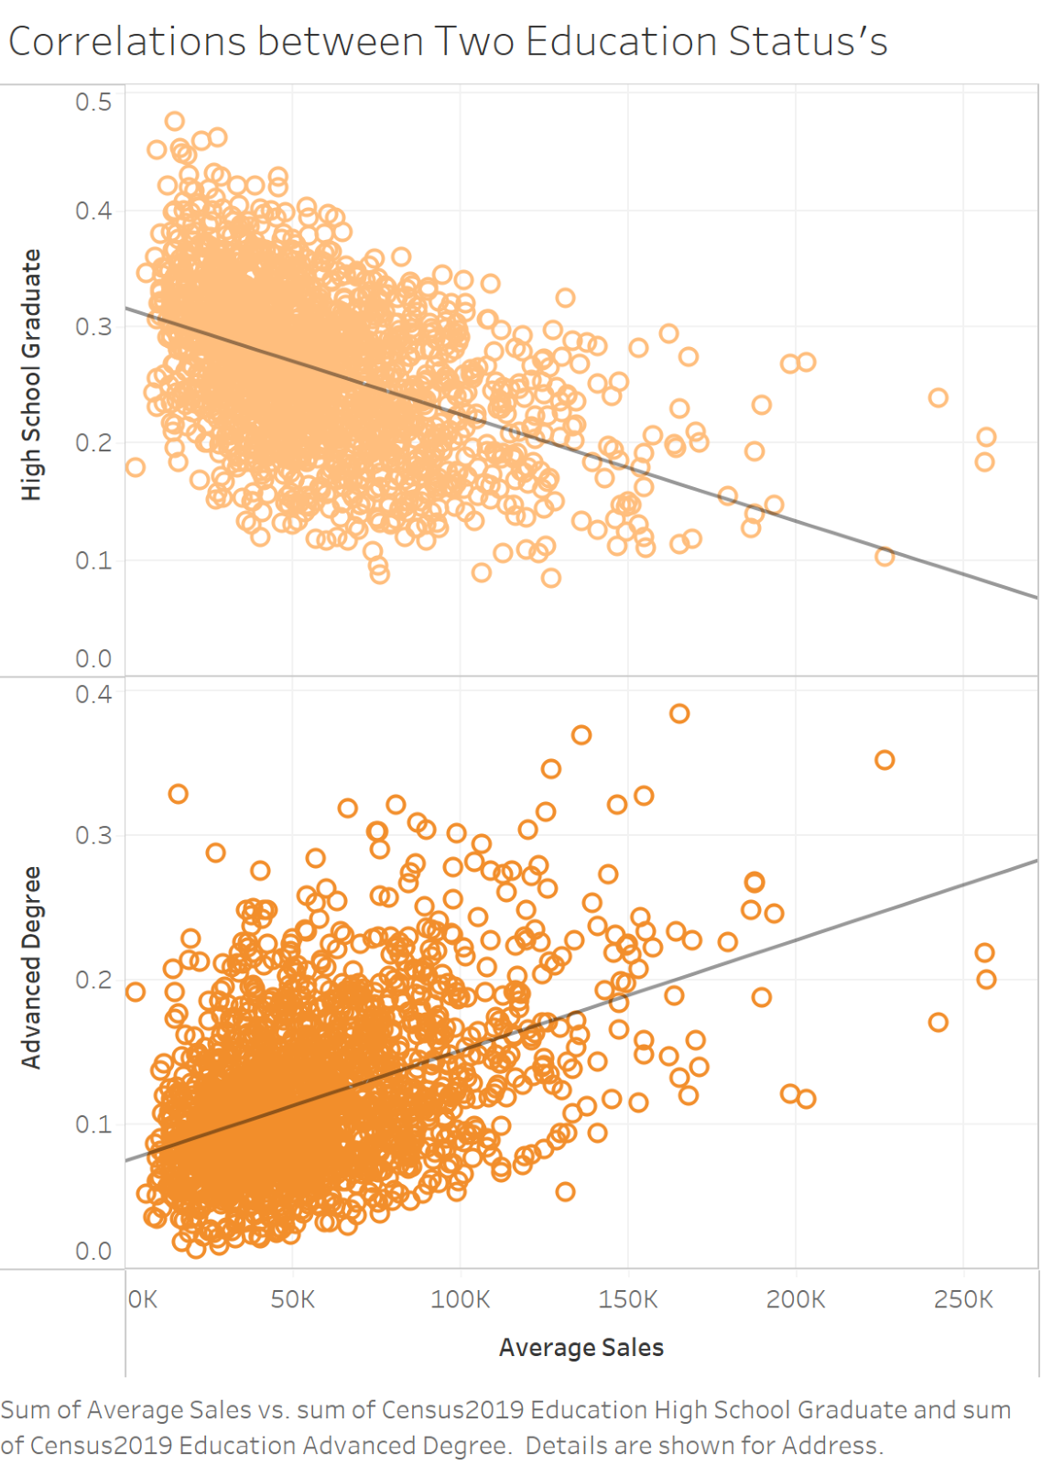
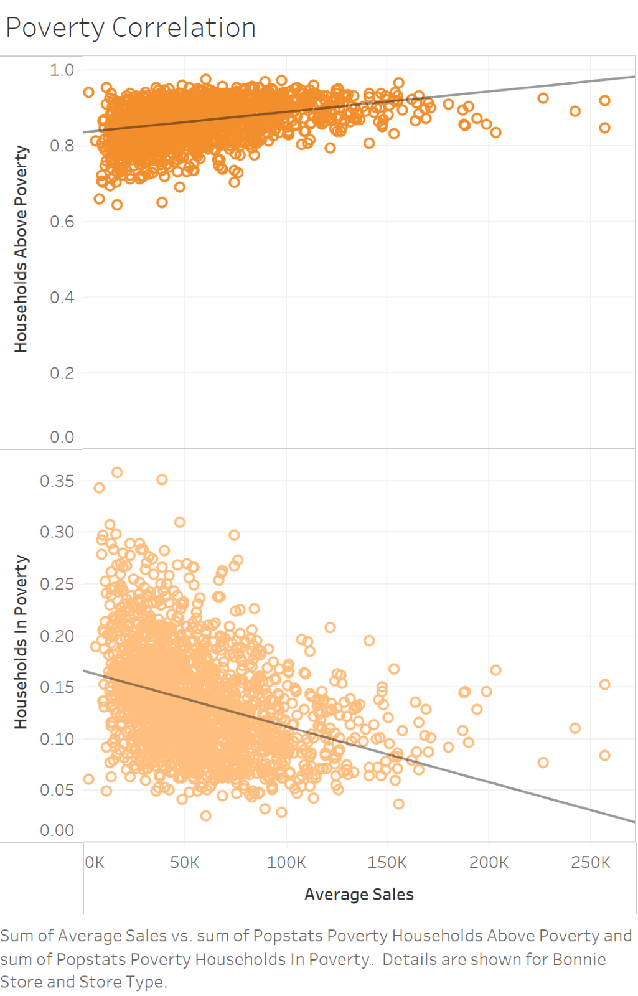
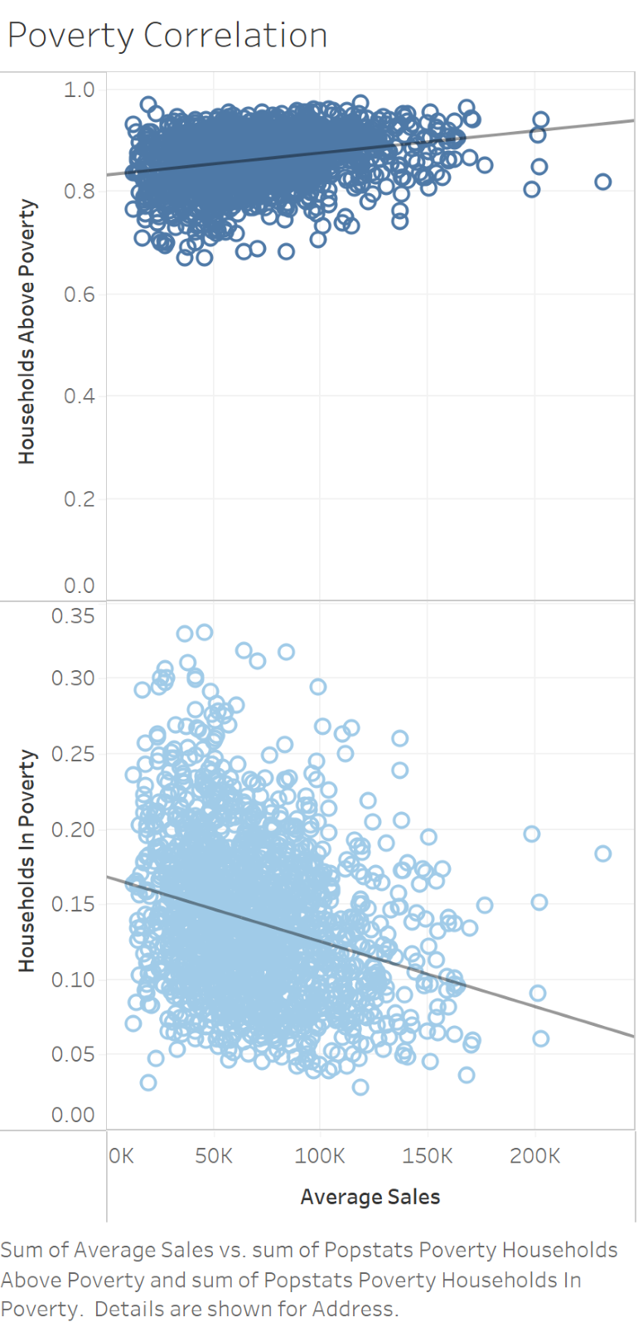
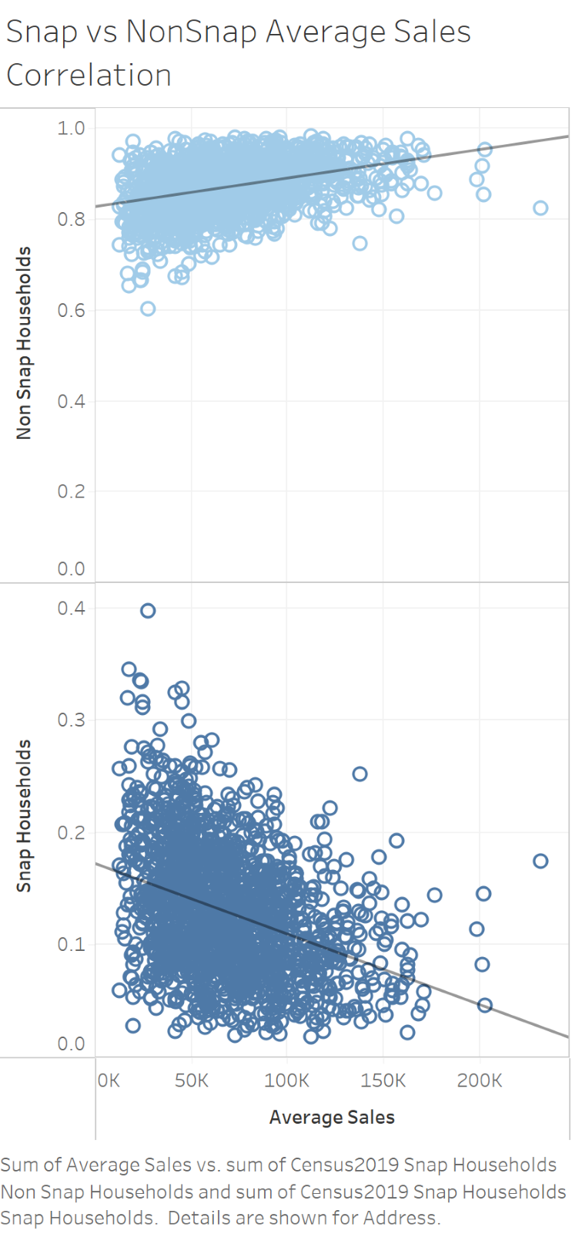
“I beg your garden?”
Team 1
The ONE and Only
Christian Conboy, Sam Easterling, Haley Harless, Emma Meeks, Joshua Picott, Savannah Street
Faculty Advisor: Dr. Pankush Kalgotra
INTRODUCTION
Descriptive Analysis
___
Predictive Analysis
Bonnie Plants provided sales and demographic data from purchases at Lowe’s and The Home Depot from the past two years.
Analyzed this data to provide valuable insights for Bonnie Plants
We decided to pursue the following three business questions:
Correlation between foot traffic and sales
Grouping of stores based on sales levels
Comparing the effects of demographics on Lowe’s v. Home Depot
THE HOME DEPOT
LOWE’S
LINEAR REGRESSION
THE HOME DEPOT
LOWE’S
DATA
DECISION TREES
Some variables were outsourced from Placer.ai (a program that tracks cell phones and subsequent demographic data), and others were created by our team for analytical purposes.
Stores were segmented evenly based on average_sales into categories high, medium, and low. Each category contains 33% of the store locations.
Foot traffic has a stronger correlation with average_sales for “High” selling store types.
Foot traffic has a stronger correlation with average_sales for “High” selling store types.
METHOD
REGIONAL SUBTOTAL:
CENTRAL - $3,852,068.2
OHIO VALLEY - $12,617,549.77
WEST - $20,179,600.29
PACIFIC NW - $11,556,384.39
SOUTH - $5,905,294.05
NORTHEAST - $16,047,690.03
REGIONAL SUBTOTAL:
CENTRAL - $8,444,864.06
OHIO VALLEY - $18,420,544.69
WEST - $10,926,288.22
PACIFIC NW - $8,094,844.96
SOUTH - $38,620,258.6
NORTHEAST - $8,593,858.94
CONCLUSIONS & LOOKING FORWARD
Home Depot has most of its sales from the Northeast, West, and Ohio Valley regions.
Lowe’s has most of its sales from the South, Ohio Valley, and West regions.
There’s different demographics buying Bonnie Plants at Home Depot & Lowe’s
  Home Depot: booming with confidence, young city solos, advanced degree (non-execs, non-specialty profession), information industry
  Lowe’s: power-elite, not in poverty, promising families
Bonnie Plants should approach marketing for these two retailers differently
Bonnie Plants should perform similar analysis for online purchases
Consider collecting data on placement of product on store floor, individual product sales, and customer satisfaction to have a more well-rounded understanding of Bonnie Plants’ customers
REFERENCES & ACKNOWLEDGEMENTS
This work was conducted using data provided by Bonnie Plants. Any opinions, findings, conclusions, and/or recommendations are those of the authors and do not necessarily reflect the views of Bonnie Plants.
Having an advanced degree and households above poverty are two variables with strong positive correlations to sales for Home Depot
Households above poverty & subsequently non-Snap households have positive correlations to sales for Lowe’s
Notes:
Team 1:
The One and Only
Team Members:
Christian Conboy, Sam Easterling, Haley Harless, Emma Meeks, Joshua Picott, Savannah Street
Introduction:
Bonnie Plants provided sales and demographic data from purchases at Lowe’s and The Home Depot from the past two years.
Analyzed this data to provide valuable insights for Bonnie Plants.
We decided to pursue the following three business questions:
1. Correlation between foot traffic and sales
2. Grouping of stores based on sales levels
3. Comparing the effects of demographics on Lowe’s v. Home Depot
Average Sales & Foot Traffic for Home Depot:
The scatter plot shows that foot traffic has a stronger correlation with average_sales for “High” selling store types.
Correlations between Two Education Status’s and Poverty Corrletation for
Home Depot:
The scatter plot shows that having an advanced degree and households above poverty are two variables that have strong positive correlations to sales for Home Depot.
Average Sales & Foot Traffic for Lowe’s:
The scatter plot shows that foot traffic has stronger correlation with average_sales for “High” selling store types.
Poverty Correlation and Snap vs. NonSnap Average Sales Correlation:
The scatter plot shows that households above poverty and subsequently non-Snap households have positive correlations to sales for Lowe’s.
Conclusions:
There’s different demographics buying Bonnie Plants at Home Depot & Lowe’s
Home Depot: booming with confidence, young city silos, advanced degree (non-execs, non-specialty profession), information industry
Lowe’s: power-elite, not in poverty, promising families
Bonnie Plants should approach marketing for these two retailers differently
Bonnie Plants should perform similar analysis for online purchases
Consider collecting data on placement of product on store floor, individual product sales, and customer satisfaction to have a more well-rounded understanding of Bonnie Plants’ customers

Slide 2


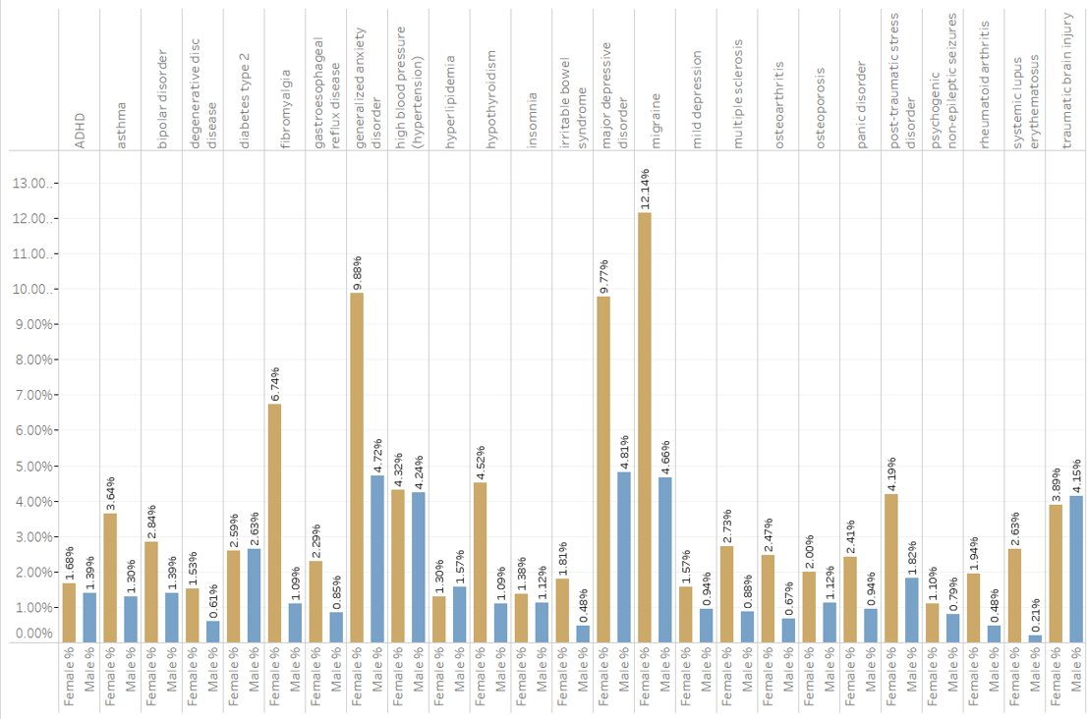
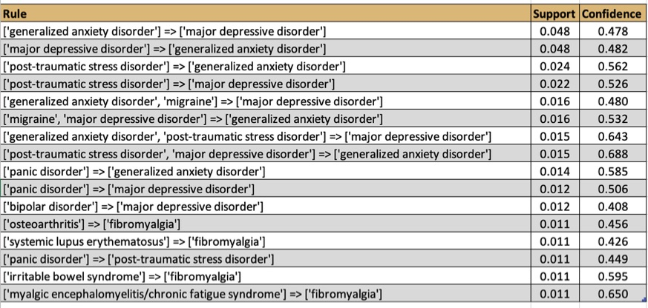
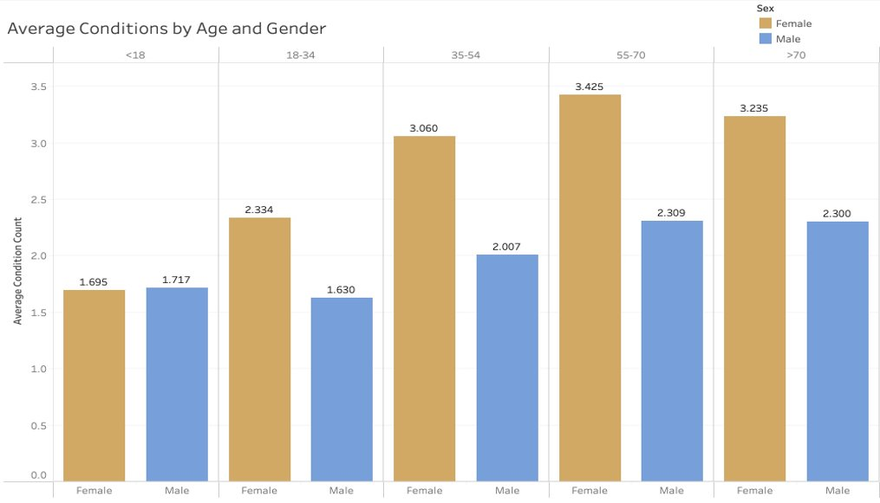

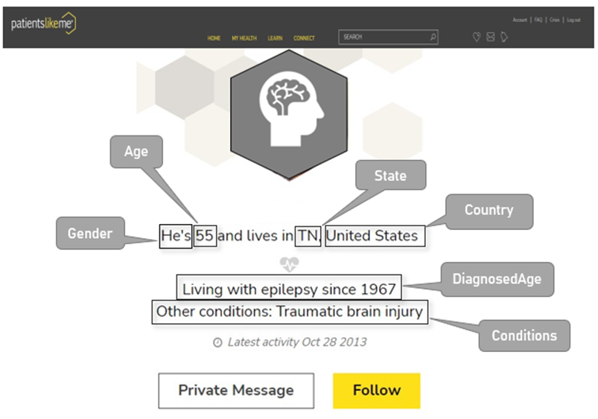

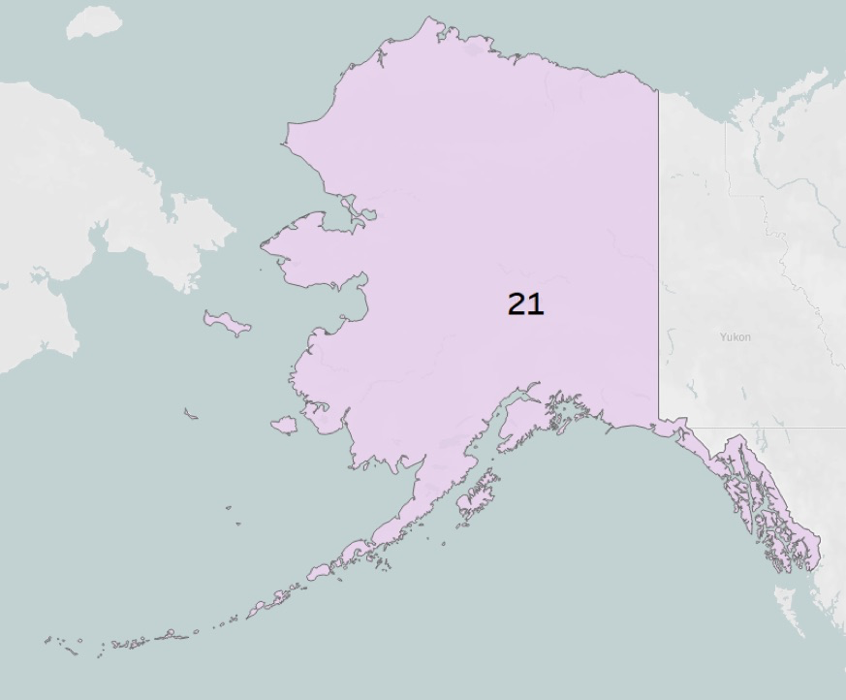
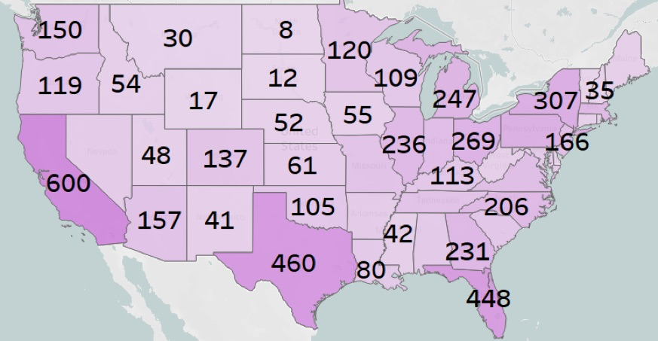
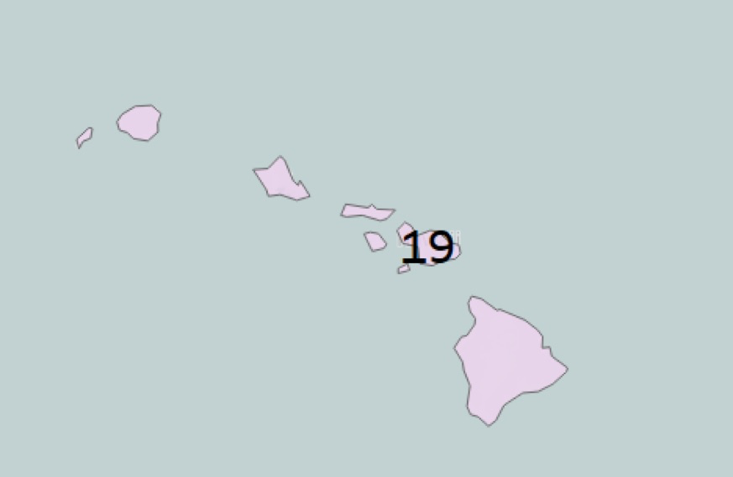
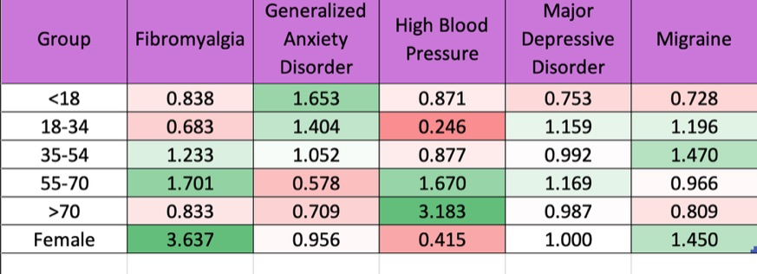
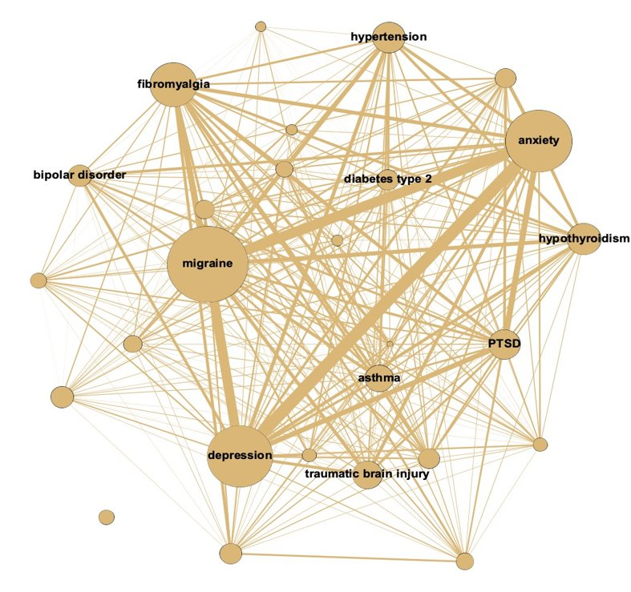
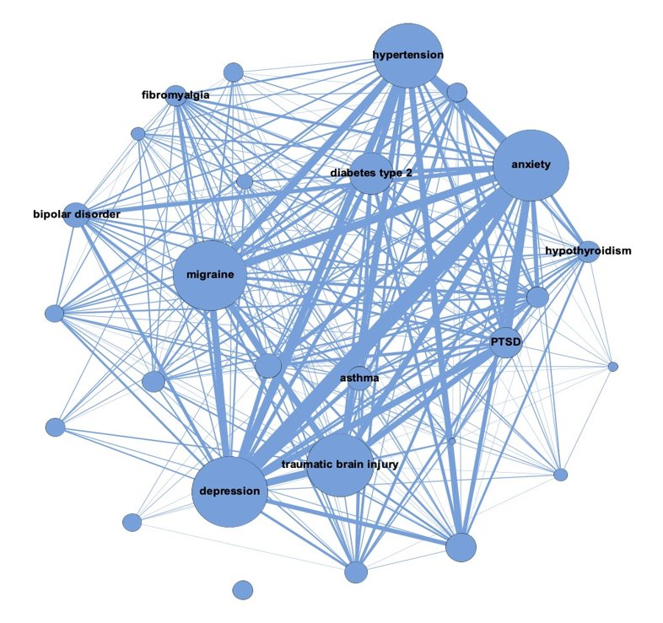
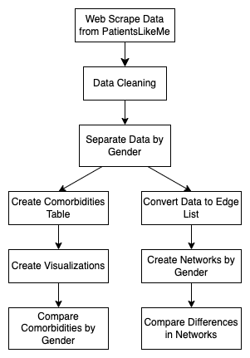
Does Epilepsy Care Who You Are? YES!!
Team 2
Model Behavior | Matthew Myers, Chris Cox, Grace Turney, Alex Hamm, Nick Knautz | Auburn University, Business Analytics
Faculty Advisor: Dr. Pankush Kalgotra
Introduction
Descriptive Analysis
Association Rules
  Average Life Expectancy reduction for patients with epilepsy
  Male: 12 years Female: 11 years
  Average Life Expectancy reduction for patients with epilepsy and mental health is reduced by up to 16 years.
  Sudden unexpected death occurs more often in people 21 to 40 compared to other age groups.
  Epilepsy currently affects roughly 3.4 million people in the US.
Out of all the females in the study,
  12.14% reported migraines
  9.88% reported anxiety disorder
  6.74% reported fibromyalgia
Out of all the males in the study,
  4.81% reported depression
  4.72% reported anxiety disorder
  4.15% reported brain injury
Dataset Description
Total of 12,060 patients included in this study (2022)
Population of epilepsy users on PatientsLikeMe website.
Scraped data from www.PatientsLikeMe.com
Females: number of conditions increased gradually until they were 71.
As for men, number of conditions seemed to increase AFTER age 34 and then stayed consistent.
​More association rules appear in the female data​
The highest association for both genders was anxiety and depression​
The highest confidence of any rule was PTSD and depression resulting in anxiety​ in women
21
Top 3 states reported in the study
  California- 600 patients
  Texas- 460 patients
  Florida- 448 patients
Classification Model – Logistic Regression (Odds Ratio)
Unsupervised Machine Learning: Network Analysis
Methodology
Female
Male
After Data cleaning:
Total Patients: 10,554
Male Patients: 3,304
Female Patients: 7,250
Age Groups:
<18
Male: 133
Female: 140
18-34
Male: 614
Female: 1477
35-54
Male: 1486
Female: 3774
55-70
Male: 854
Female: 1638
>70
Male: 217
Female: 221
Fibromyalgia is 3.64 times more prevalent in women.​
High blood pressure is most significantly affected by age.
Anxiety decreased in likelihood as age increased.
High blood pressure is more common in men than women.
Conclusions
Our research suggests that gender-specific as well as age-specific health care should be considered when treating epilepsy.
​
Different treatments should be conducted for males and females to prevent negative emotional comorbidities.
Create a plan to access mental health of epilepsy patients and treat as needed.
More research should be conducted to identify if race is a factor as well.
Size of nodes indicate comorbidity of disease with epilepsy.
Generalized anxiety and depression is the top connection with 56 males and 246 females.
The second connection is anxiety and hypertension for males and anxiety and migraines for females.
Diseases are more interconnected in the female network
Notes:
Team 2:
Model Behavior
Team Members:
Matthew Myers, Chris Cox, Grace Turney, Alex Hamm, Nick Knautz
Introduction:
Average Life Expectancy reduction for patients with epilepsy
Male: 12 years
Female: 11 years
Average Life Expectancy reduction for patients with epilepsy and mental health is reduced by up to 16 years.
Sudden unexpected death occurrs more often in people 21 to 40 compared to other age groups.
Epilepsy currently affects roughly 3.4 million people in the US.
Descriptive Analysis of Females and Males with epilepsy:
The bar graph shows the percentage of females and males effected by different effects of epilepsy:
Females:
12.14% reported migraines
9.88% reported anxiety disorder
6.74% reported fibromyalgia
Males:
4.81% reported depression
4.72% reported anxiety disorder
4.15% reported brain injury
Average Conditions by Age and Gender
The bar graph shows that Females number of conditions increased gradually until they were 71, while Males number of conditions seemed to increase AFTER age 34 and then stayed consistent.
Conclusions:
Our research suggests that gender-specific as well as age-specific health care should be considered when treating epilepsy.
Different treatments should be conducted for males and females to prevent negative emotional comorbidities.
Create a plan to access mental health of epilepsy patients and treat as needed.
More research should be conducted to identify if race is a factor as well.

Slide 3

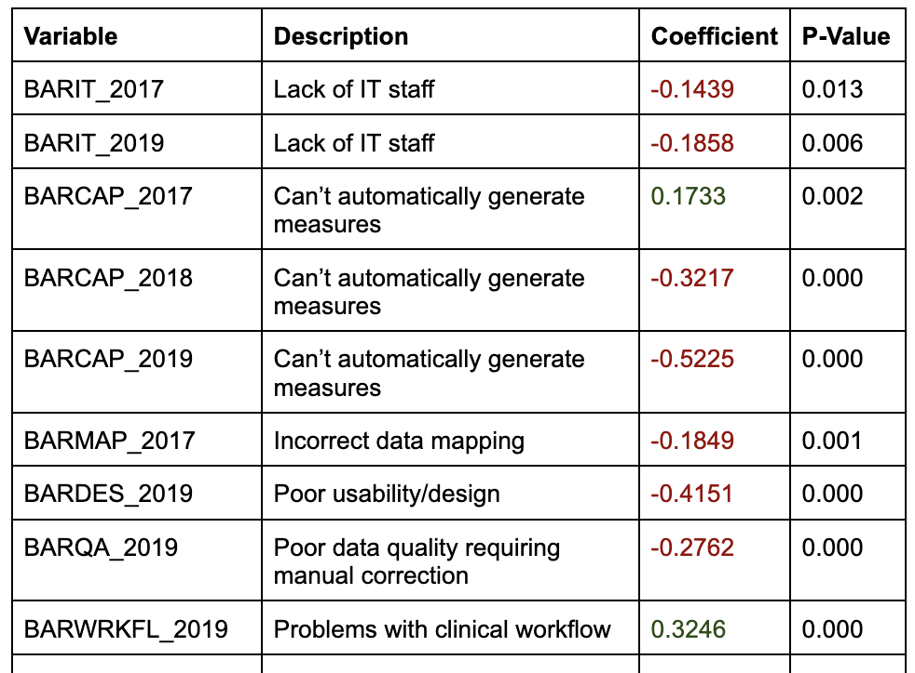
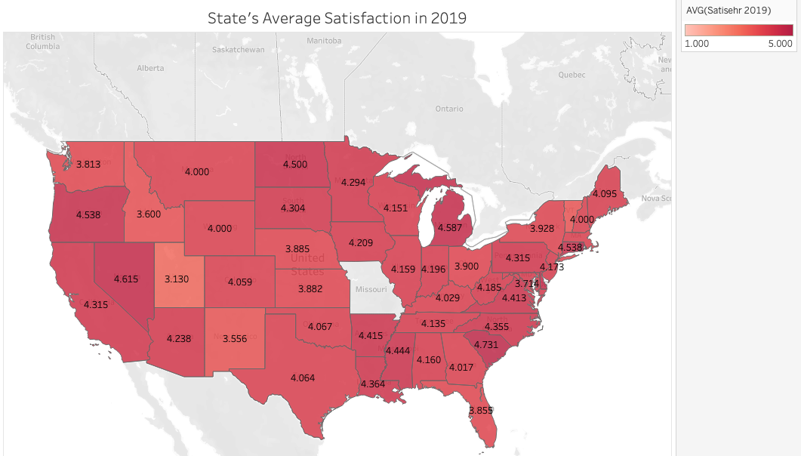
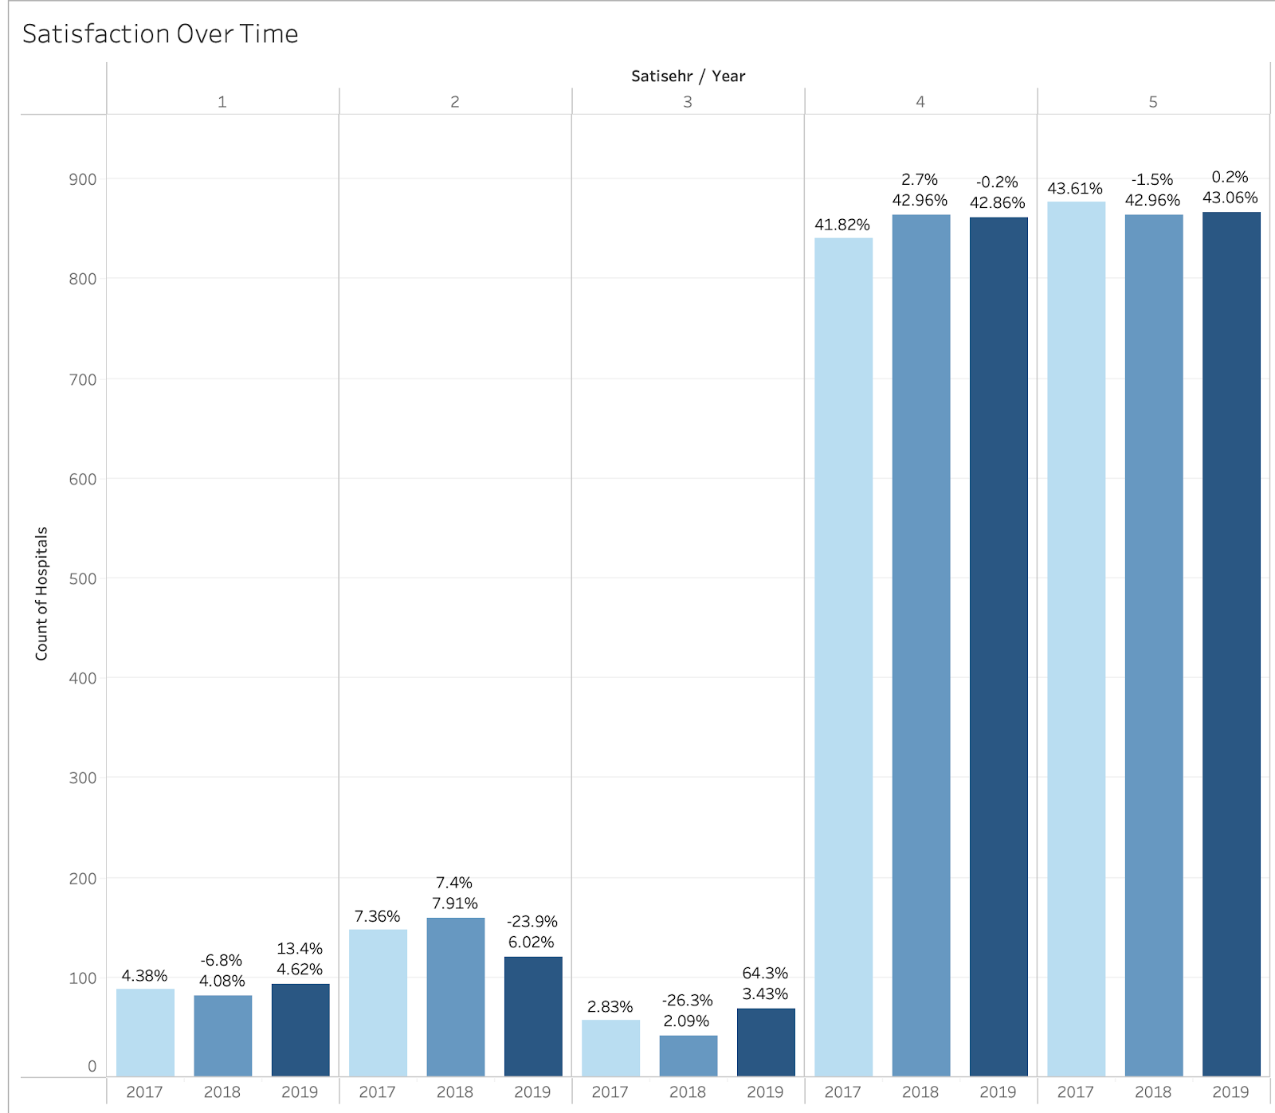
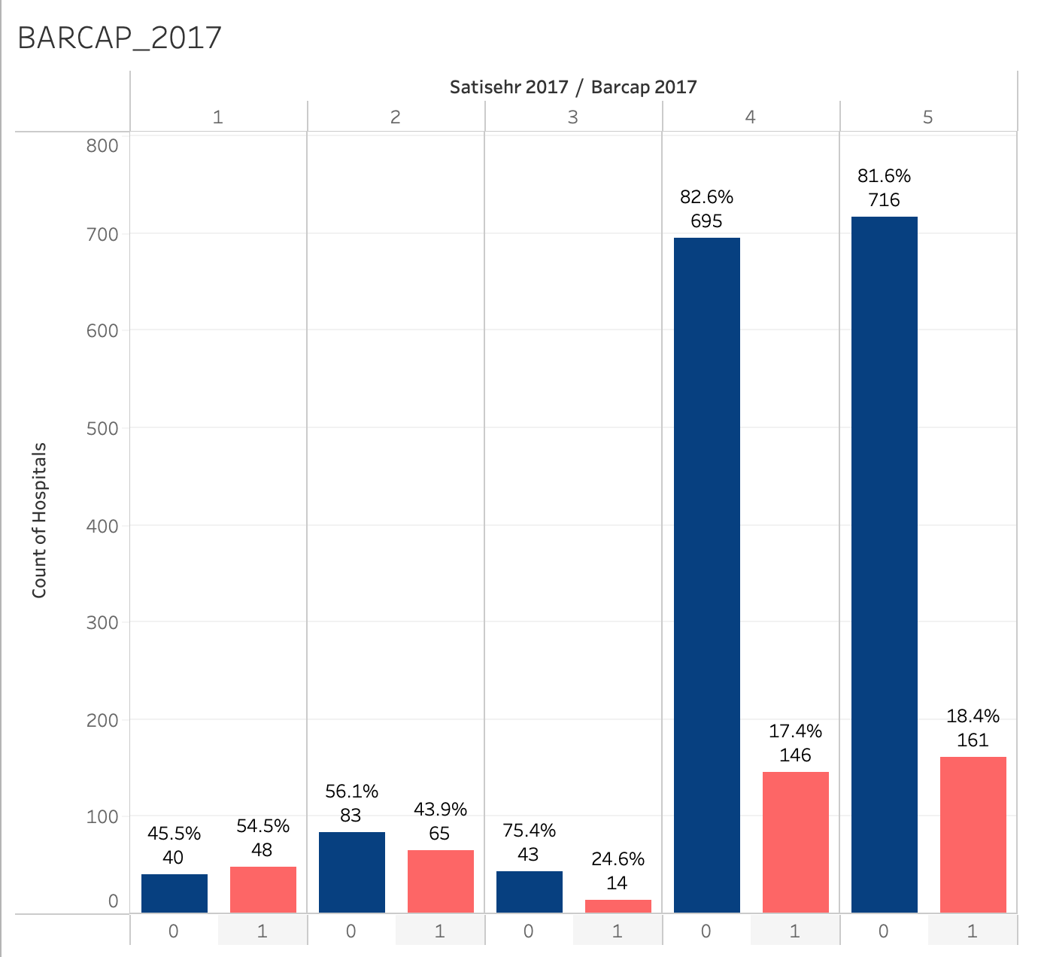
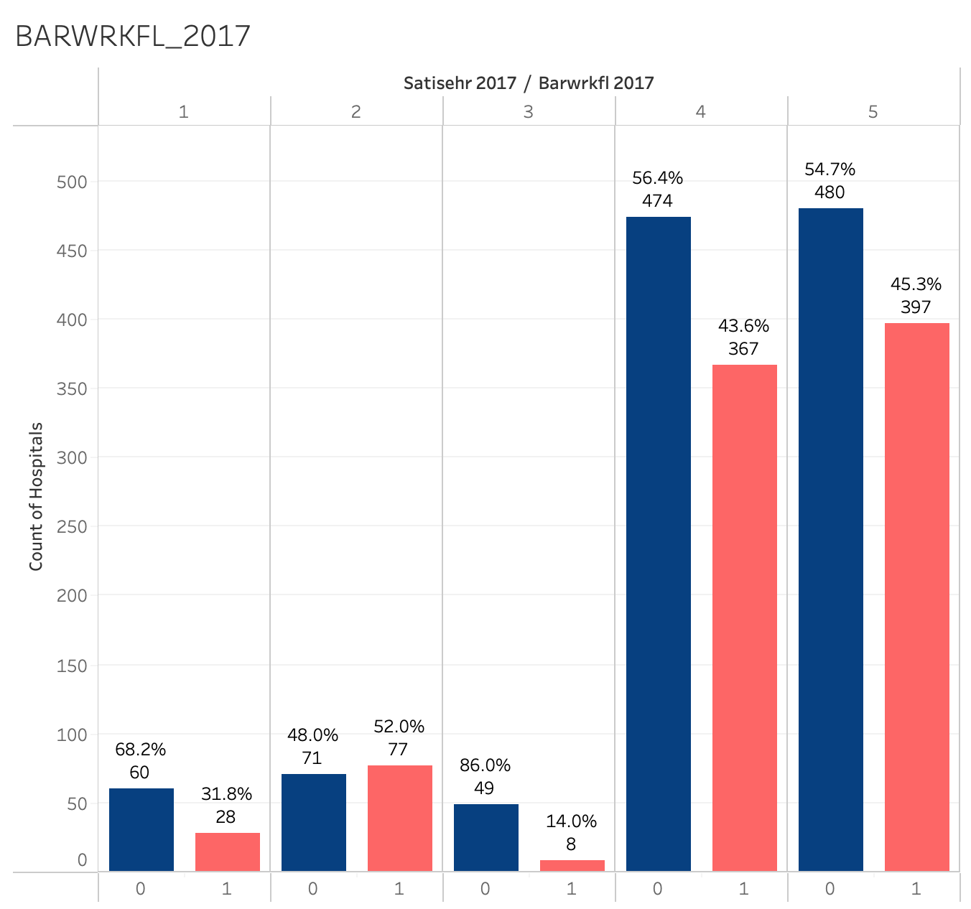
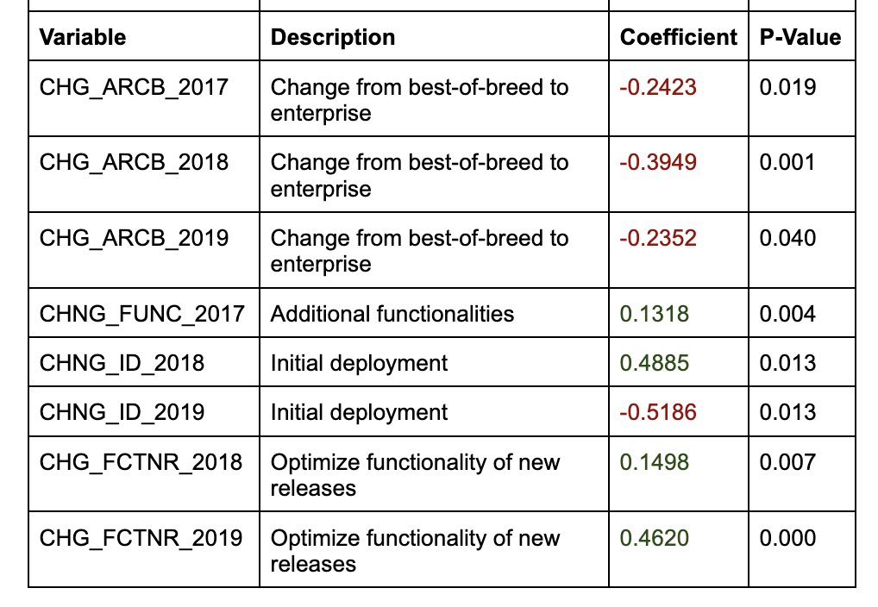
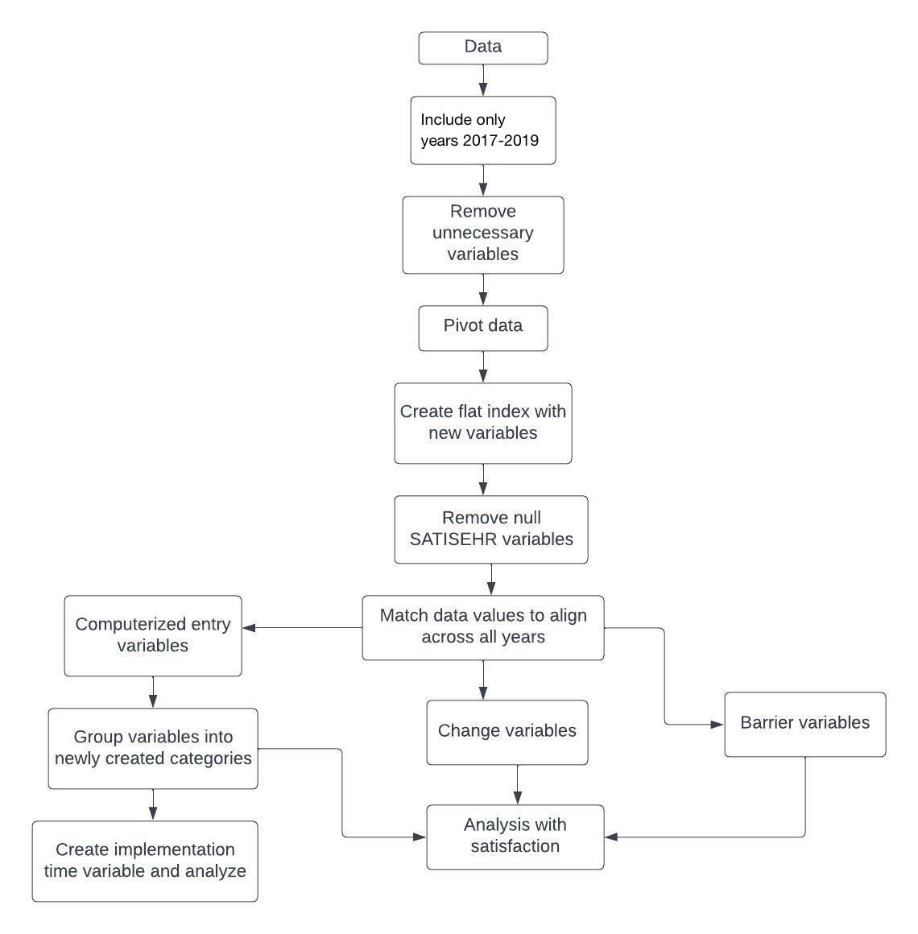
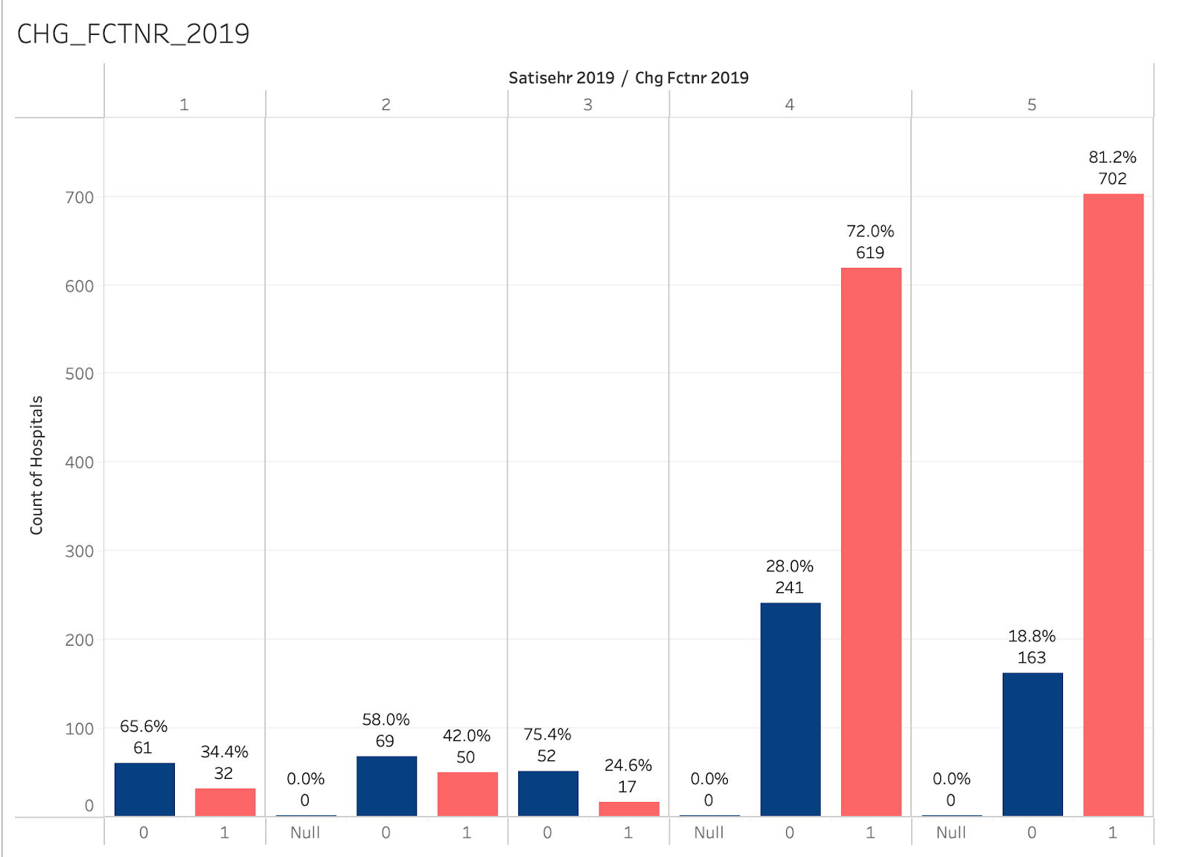
Are hospitals satisfied with their systems? Better Tech for Better Care
Team 3
GoTech Group: Kassie Johnson, Kathryn Burrows, Matthew Siegfried, Zachary Hyde
Professor: Dr. Pankush Kalgotra
Introduction
Descriptive Analysis
Regression
Problem
Outdated systems cost hospitals ~$8.3B annually
Poor systems = longer patient discharge times and decreased productivity
Motivation
Well-performing EHR systems = maximized efficiency improving both employee and patient experience
Research Question
How do different features, barriers, and plans for change in EHR systems affect overall hospital satisfaction?
Are these variables changing over time?
Satisfaction
R-squared: 0.961
Dataset Description
Satisfaction was high for most hospitals
Satisfaction distributions did not change much across the three years
Indication of most barriers tends to negatively affect satisfaction, and more so when the barrier is reported more recently (more recent = less time to address the concern).
A barrier to clinical workflow increases satisfaction by 0.3246 (our greatest barrier and majority of hospitals have 4s or 5s).
American Hospital Association (AHA) annual surveys
2,011 Hospitals
Surveyed from 2017-2019
Satisfaction scale 1-5
Technology Features Variables
  Lists, medications, notes, labs, tests, etc.
Barrier Variables
  Incorrect data, lack of staff, inability to automate measures, etc.
Change Variables
  Type of system, addition of functionalities, optimization
Barriers
Method Flowchart
The barrier variables indicated that low-satisfaction hospitals had a greater distribution of ‘1’s:
Inability to automatically generate measures
Inaccurate information
Difficulty extracting information
Data quality requiring manual collection
We saw a minimal change over time (‘17- ‘19)
Indication of plans to change from best-of-breed decreases satisfaction (meaning likely unhappy with best-of-breed).
Evidence of plans to add and optimize functionalities increases satisfaction. This reaffirms a greater presence of this plan for change with higher satisfaction.
Barriers to clinical workflow are common across all satisfaction levels.
This was the greatest known barrier (44% reported in 2017).
Clinical workflow is key for full utilization of EHR systems.
Conclusions
Barriers such as mapping, design, and data quality are more prevalent in hospitals with low satisfaction ratings.
Focus areas for improvement in hospitals that are unsatisfied.
Barriers relating to clinical workflow are a problem for many hospitals regardless of satisfaction.
Reevaluate ways to improve internal processes using EHR systems to ensure systems are used to the greatest extent; otherwise, the investment serves no purpose.
Hospitals with higher satisfaction more commonly want to add additional features and optimize their functionality.
Hospitals are constantly finding room for improvement and development. This should be the end goal for all hospitals.
Change
Hospitals were more likely to plan to switch to an enterprise system than to best-of-breed.
Plans to add additional new features and optimize the functionality of new releases were more commonly indicated for hospitals with higher satisfaction.
Notes:
Team 3:
GoTech Group
Team Members:
Kassie Johnson, Kathryn Burrows, Matthew Siegfried, Zachary Hyde
Introduction:
Problem
Outdated systems cost hospitals ~$8.3B annually
Poor systems = longer patient discharge times and decreased productivity
Motivation
Well-performing EHR systems = maximized efficiency improving both employee and patient experience
Research Question
How do different features, barriers, and plans for change in EHR systems affect overall hospital satisfaction?
Are these variables changing over time?
Satisfaction in Hospitals using EHR systems:
The bar graph shows a survey of American Hospitals from 2017-2019. Satisfaction was high for most hospitals, and satisfaction distributions did not change much across the three years.
Barriers Variables:
The bar graph shows the barrier variables indicated that low satisfaction hospitals had a greater distribution of ‘1’s on a scale of 1-5 satisfaction. Minimal change happens over time (2017-2019).
The second bar graph shows that barriers to clinical workflow are common across all satisfaction levels. This was the greatest known barrier (44% reported in 2017).
Change Variables:
The bar graph shows that hospitals were more likely to plan to switch to an enterprise system than to best-of-breed. Plans to add additional new features and optimize the functionality of new releases were more commonly indicated for hospitals with higher satisfaction.
Conclusions:
Barriers such as mapping, design, and data quality are more prevalent in hospitals with low satisfaction ratings.
Focus areas for improvement in hospitals that are unsatisfied.
Barriers relating to clinical workflow are a problem for many hospitals regardless of satisfaction.
Reevaluate ways to improve internal processes using EHR systems to ensure systems are used to the greatest extent; otherwise, the investment serves no purpose.
Hospitals with higher satisfaction more commonly want to add additional features and optimize their functionality.
Hospitals are constantly finding room for improvement and development. This should be the end goal for all hospitals.

Slide 4

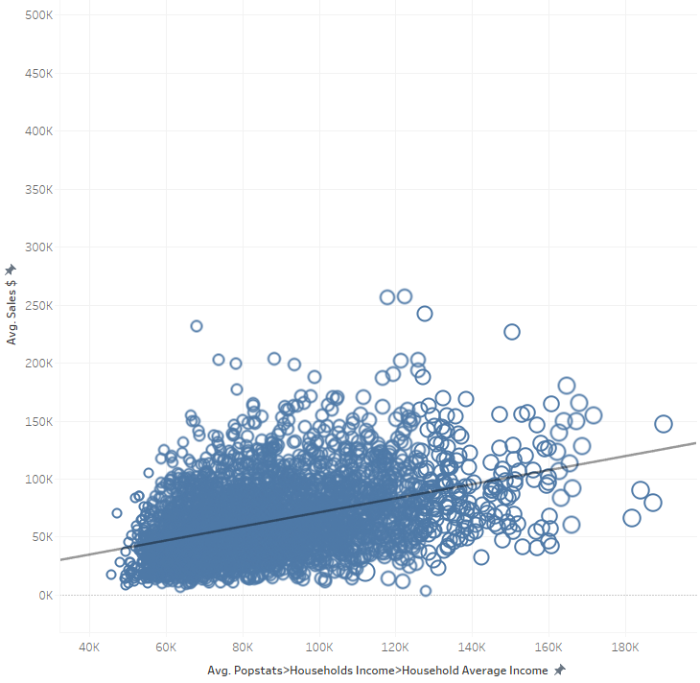
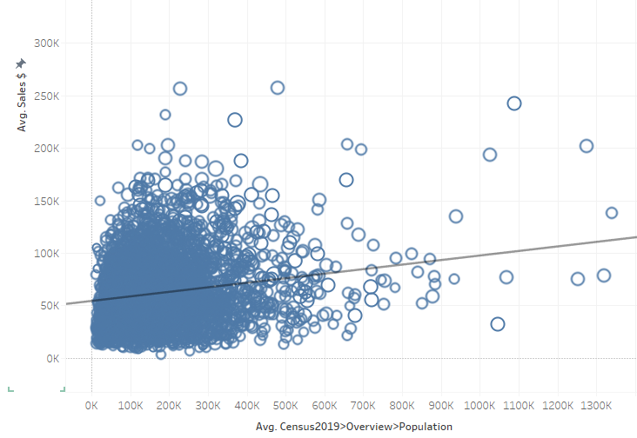
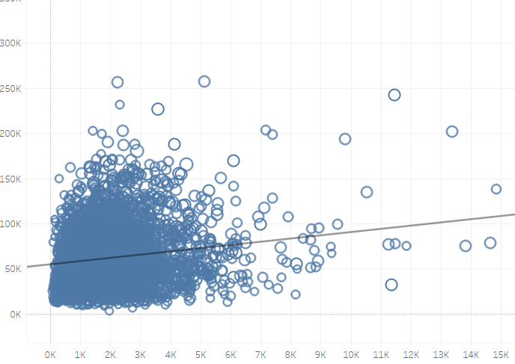
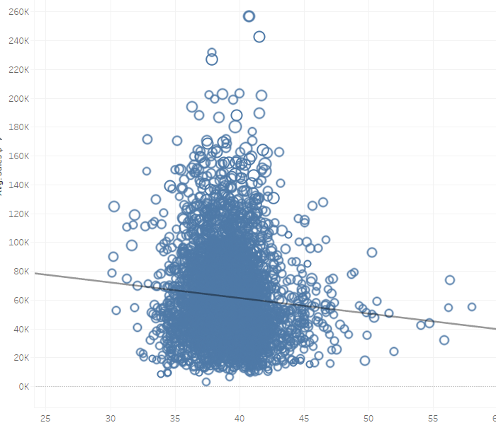
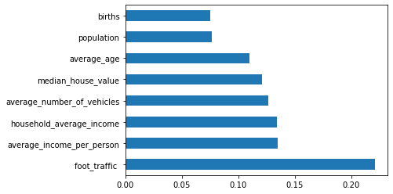
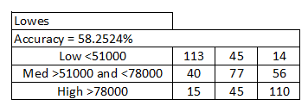
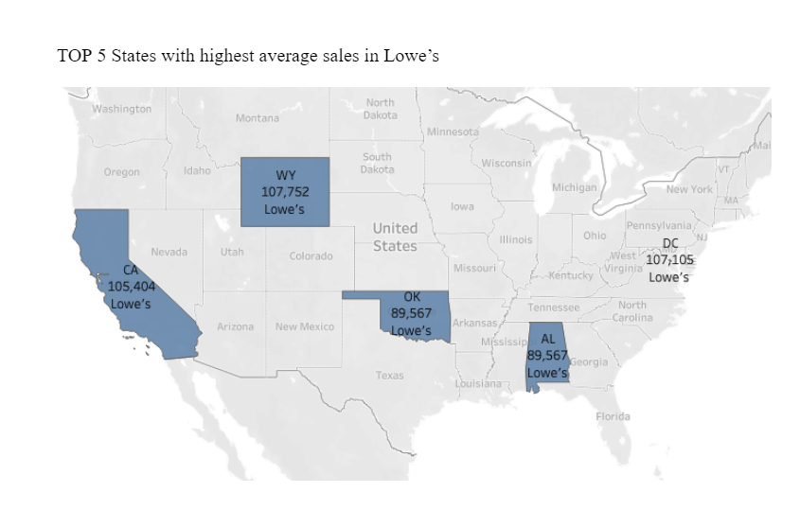
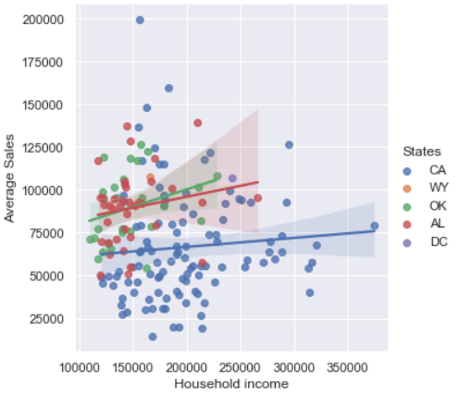
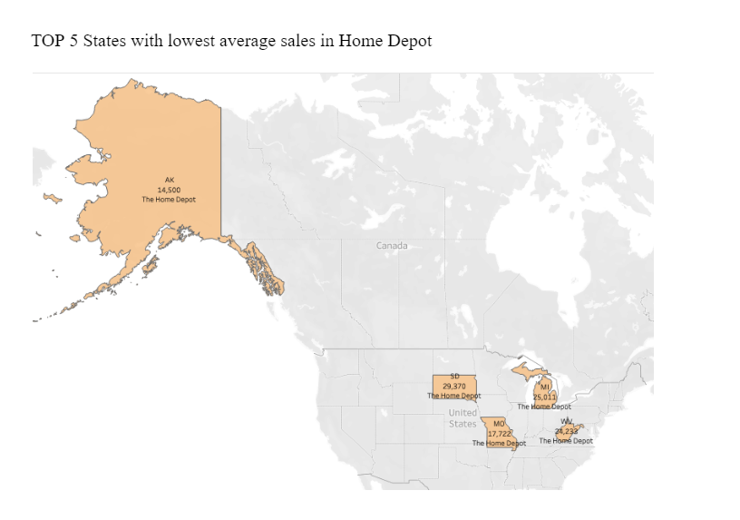
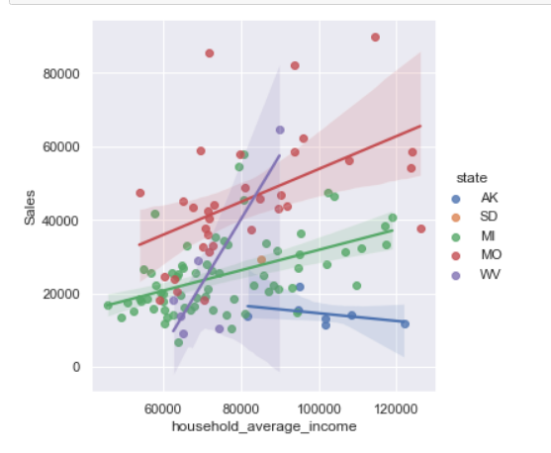










Buy More Plants
Team 4
We Tried: Weixin Qin, Dingbang Zhang, Evan Hunter Jr., Jake Borah, Jiachen Zhao, Professor: Dr. Pankush Kalgotra
Introduction
Descriptive Analysis
Predictive Modeling- Random forest
Target retail and household sales in the U.S. market
Majority of retail sales stems from partnerships with Lowes, and Home Depot.
Their national sales geography is categorized into six regions, with their fall season accounting for roughly 5% of total revenues (8/1-1/1) and the spring season 95%
Dependent Variable: Store Category (Low, Medium and High)
Independent variables: foot_tradffic, average_age, household_average_income, median_house_value, average_number_of_vehicles, Biths, Population
Motivation and Business Problems
Visualizations
Random forest & Confusion Matrix for Lowes
Our team wanted to focus on the Bonnie Plants data to present decision-useful information to the company.
Help identify low performers and potential opportunities
Highlight operational efficiencies and risks
What factors affect sales the most? (around this problem)
What’s the similarity between those lowest-sales states
What’s the similarity between those highest-sales states
What can we learn from previous data
Random forest & Confusion Matrix for Home Depot
Conclusions and Implications
Variable Description
What factors affect sales the most? (around this problem)
foot traffic and average income
What’s the similarity between those lowest-sales states
They all have similar locations and all close to north. Also, the household average income is similar.
What’s the similarity between those highest-sales states
They all have high household income and foot traffic.
What’s interesting about the data?
For the lowest five state, foot traffic will be most important variable for the sale
DC is the only one state has the highest sale in Home depot and Lowe’s
Suggestions
Method Flowchart
Statistical modeling
1. Need to pay more attention to foot traffic, average income per person, and average household value. These are the three main variables that influence the sales
2. Since some states have the lowest sale no matter in Lowes or Home Depot, they have low value to invest. If Bonnie plants want to open some new stores, don't choose those states
3. DC is the only Top 5 average state within Lowes and Home Depot categories. The main reason is that it only has two stores, and they are all doing good. Therefore, Bonnie plants can open some new stores in DC, it will probably make more profit than other places
Acknowledgment
This work was conducted on data provided by Bonnie Plants
Notes:
Team 4:
We Tried
Team Members:
Weixin Qin, Dingbang Zhang, Evan Hunter Jr., Jake Borah, Jiachen Zhao
Introduction:
Target retail and household sales in the U.S. market.
Majority of retail sales stems from partnerships with Lowes, and Home Depot.
Their national sales geography is categorized into six regions, with their fall season accounting for roughly 5% of total revenues (8/1-1/1) and the spring season 95%.
Top 5 states with highest average sales in Lowe’s vs. top 5 states with lowest average sales in Lowe’s:
The scatter plot shows a gradual increase in sales as household incomes rise in the highest averaging sale states.
The second scatter plot shows only a slight increase in sales as household incomes rise in the lowest averaging sale states.
Top 5 states with highest average sales in Home Depot vs. top 5 states with lowest averaging sales in Home Depot:
The scatter plot shows a steep increase in sales as household incomes rise in the highest averaging sale states.
The second scatter plot shows a more mixed yet steady increase in sales as household incomes rise in the lowest averaging sale states.
Conclusions:
What factors affect sales the most? (around this problem)
Foot traffic and average income
What’s the similarity between those lowest-sales states
They all have similar locations and all close to north. Also, the household average income is similar.
What’s the similarity between those highest-sales states
They all have high household income and foot traffic.
What’s interesting about the data?
For the lowest five state, foot traffic will be most important variable for the sale DC is the only one state has the highest sale in Home depot and Lowe’s.

Slide 5









MLB Games and Crime Rates: Stealing more than just bases
Team 5
Run Rulers
Bridget Catalano, Preston Vinzant, Pan Li, Ben Stana, James Richardson, Yilidanna Yimingjiang
Faculty advisor: Dr. Pankush Kalgotra
Problem/Question
Problem/Question
Regression Tree
Baseball is America's favorite pastime, making it beyond popular in every state across the USA.
The Braves and Red Sox have very supportive home crowds. People often travel from all over the country to these teams' respective cities(Atlanta and Boston) to support these two franchises
Does the influx of people and game results affect the crime rates for Atlanta and Boston?
Is there a difference in crime during pre-gamedays, gamedays, and post-gamedays?
Answering these questions could potentially help law enforcement
The results we found were very interesting and point to important information that could be useful to law enforcement in Boston and Atlanta.
Y-variable: Total number of crimes on game day
X-variable: All crime data that occurred before and on game day
Training Data: 80% of data (randomly selected)
Tree Depth = 3
Atlanta Tree Model
Mean Absolute Percent Error (MAPE) = 0.1694
83% prediction accuracy
Dataset and Methodology
This figure shows the daily average of crimes committed in Atlanta from 2015-2021 filtered by month as well as before, gameday, after, and between gamedays.
This figure shows the daily average of each individual crime committed in Atlanta from 2015-2021 filtered by before, gameday, after, and between gamedays.
Created two types of datasets: Crime and game schedule
Two cities: Atlanta and Boston
Time frame – 2015-2021
Looked at roughly 500 home games per each city
Crimes Considered – Aggravated Assault, Auto Theft, Burglary, Larceny, Robbery.
Boston Tree Model
Variable | Description | Atlanta | Boston
Aggravated Assault | Average of Aggravated Assault base on gamedays Gameday: Before: Between: After: | Average 6.37 6.12 6.31 6.30 | Average 21.29 19.92 19.91 20.62
Auto Theft | Average of Auto Theft base on gamedays Gameday: Before: Between: After: | Average 9.74 9.94 10.34 9.43 | Average 4.45 3.92 4.45 4.59
Burglary | Average of Burglary base on gamedays Gameday: Before: Between: After: | Average 8.85 9.01 10.21 8.76 | Average 5.83 5.43 5.71 6.59
Larceny | Average of Larceny base on gamedays Gameday: Before: Between: After: | Average 43.67 43.36 46.39 44.31 | Average 32.79 31.30 31.50 33.38
Robbery | Average of Robbery base on gamedays Gameday: Before: Between: After: | Average 3.86 3.92 3.72 3.94 | Average 4.44 3.94 3.93 4.49
Total Crime | Average of total crime number based on gamedays Gameday: Before: Between: After: | Average 72.83 72.65 77.36 73.07 | Average 68.97 64.65 65.62 69.85
Mean Absolute Percent Error (MAPE) = 0.1361
86% prediction accuracy
This figure shows the daily average of crimes committed in Boston from 2015-2021 filtered by month as well as before, gameday, after, and between gamedays.
This figure shows the daily average of each individual crime committed in Boston from 2015-2021 filtered by before, gameday, after, and between gamedays.
Timeline
Linear Regression Model
Conclusion
Atlanta
Target Variable | Total number of crimes on game day
Variable | coefficient | P value
Win | -0.8150 | 0.707
Average Aggravated Assault before gameday | 0.2649 | 0.553
Average Auto Theft before gameday | 0.3237 | 0.308
Average Burglary before gameday | 0.3909 | 0.200
Average Larceny before gameday | 0.5299 | 0.000
Average Robbery before gameday | 1.1926 | 0.049
R square | 0.348
Boston
Target Variable | Total number of crimes on game day
Variable | coefficient | P value
Win | 3.4431 | 0.128
Average Aggravated Assault before gameday | 0.9707 | 0.000
Average Auto Theft before gameday | 0.7860 | 0.113
Average Burglary before gameday | 1.2524 | 0.005
Average Larceny before gameday | 1.0151 | 0.000
Average Robbery before gameday | 0.8576 | 0.168
R square | 0.638
The crime rates in Atlanta are highest during the “between” time frame
Boston had a higher crime rate during the “after” time frame
We can see that Larceny in Atlanta and Boston are significantly higher than any other crime rates we looked at.
Average crime rates were nearly identical for both Boston and Atlanta
Boston had a much higher average aggravated assault rate than Atlanta does.
Flowchart
Time | Description | Atlanta | Boston
Gameday | Total number of game days | 516 days | 517 days
Before | Total number of days before the game days | 533 days | 314 days
Between | Total number of days between the game days | 111 days | 204 days
After | Total number of days before the game days | 434 days | 433 days
Win and Lose | The baseball team of the is win or lose the game | Win: 265 Lose: 252 | Win: 293 Lose: 225
Notes:
Title: MLB Games and Crime Rates: Stealing more than just bases
Team: Run Rulers
Member name: Bridget Catalano, Preston Vinzant, Pan Li, Ben Stana, James Richardson, Yilidanna Yimingjiang
Problem/Question
Baseball is America's favorite pastime, making it beyond popular in every state across the USA.
The Braves and Red Sox have very supportive home crowds. People often travel from all over the country to these teams' respective cities(Atlanta and Boston) to support these two franchises
Does the influx of people and results of the game have any effect on the crime rates for Atlanta and Boston?
Is there a difference in crime during pre-gamedays, gamedays, and post-gamedays?
Answering these questions could potentially help lar enforcement
Dataset and Methodology
Created two types of datasets: Crime and game schedule
Two cities: Atlanta and Boston
Time frame – 2015-2021
Looked at roughly 500 home games per each city
Crimes Considered – Aggravated Assault, Auto Theft, Burglary, Larceny, Robbery.
The table above shows the dataset we using for analyze.
Flowchart
The flowchart shows the process of our project. We collect crime data and game schedule at beginning, then we clean the data and keep the crime data and game schedule data that in year 2015 to 2021. Then, we create the daily crimes dataset, and make the timeline dataset of the game schedule, then we merge these two datasets. We use the new dataset to analyze the relationship between the crimes and baseball game and make a visualization of the result. Finally, we create predictive models to predict the crimes in this future.
Timeline
Created 4 type of time periods: before, gameday, between and after.
Before: this time periods represents the 3 days before the gameday.
Gameday: this time periods represents the gameday.
Between: represents the days that between two game days, and it is up to 5 days.
After: represents the 3 days after game days.
Total number of game days in Atlanta and Boston are 516 days and 517 days.
Total number of days before the game days in Atlanta and Boston are 533 days and 314 days.
Total number of days between the game days in Atlanta and Boston are 111 days and 204 days.
Total number of days before the game days in Atlanta and Boston are 434 days and 433 days.
The total number of baseball team is winning the game in Atlanta and Boston are 265 days and 293 days, and total lose in Atlanta and Boston 252 days and 225 days
Results
The figure above shows the daily average of crimes committed in Atlanta from 2015-2021 filtered by month as well as before, gameday, after, and between gamedays. According to the figure the summer season has the most average of crimes in Before and Gameday. But, the most average of crimes happened in winter season.
The figure above shows the daily average of crimes committed in Boston from 2015-2021 filtered by month as well as before, gameday, after, and between gamedays. According to the figure the summer season has the most average of crimes in all four time periods.
The figure above shows the daily average of each individual crime committed in Atlanta from 2015-2021 filtered by before, gameday, after, and between gamedays. According to the figure the crime rates in Atlanta are highest during the “between” time frame.
The figure above shows the daily average of each individual crime committed in Boston from 2015-2021 filtered by before, gameday, after, and between gamedays. According to the figure, Boston had a higher crime rate during the “after” time frame.
Linear Regression Model
We use Least Squares method for this model to predict the total number of crimes on the game day. We choose the win/lose result of the game and the number of each crime that occurred before the game as independent variables.
The two figures show the result of Linear Regression Model of Atlanta and Boston. In Atlanta, number of larceny and robbery that happened before the game day have a p-value that less than 0.05. The R-square is 0.348 for Atlanta’s linear regression model, which shows that the 34.8% prediction of this model is accurate. In Boston model, the p-value of the independent variables that less than 0.05 are aggravated assault, burglary, and larceny. The R-square value of the Boston model is 0.638, which means the model have 63.8% prediction accuracy.
Regression Tree Model:
Y-variable: Total number of crimes after gameday
X-variable: All crime data that occurred before and on gameday
Training Data: 80% of data (randomly selected)
Tree Depth = 3
Atlanta Tree Model
The MAPE score of Atlanta Tree Model is 0.1694, which means the tree model has 83% prediction accuracy. the most total crime number after the game will happen when the average burglary on game day is less than 7.5, the average larceny before gameday is less than 35.5 and the average larceny on gameday is less than 45.
Boston Tree Model
The MAPE score of Atlanta Tree Model is 0.1361, which means the tree model has 86% prediction accuracy. the most total crime number after the game will happen when the average total number of crimes before the gameday is less than 73.5 and the average aggravated assault before gameday is less than 32.75.
Conclusion
The crime rates in Atlanta are highest during the “between” time frame
Boston had a higher crime rate during the “after” time frame
We can see that Larceny in Atlanta and Boston are significantly higher than any other crime rates we looked at.
Average crime rates were nearly identical for both Boston and Atlanta
Boston had a much higher average aggravated assault rate than Atlanta does.

Slide 6






The 3-Point Revolution
Team 6
3-point shooters: Alison Adam, Alex Gruver, Nelson Garris, Ben Abrams, Mason Glavine
Faculty Advisor: Dr. Pankush Kalgotra
Introduction
Methodology
Results
Conclusion
NCAA basketball is the most popular NCAA sport.
As teams keep improving, trends start to develop; setting apart teams with the athletes and training to use these gameplay trends to their advantage.
How can the NCAA use data to find trends and determine when and what rule changes need to be made in the constantly evolving environment of college athletics?
Importance:
Analyzing gameplay data can reveal trends otherwise unseen and be used to make decisions regarding the rules of the sport.
As a billion-dollar industry, it is important to make sure teams are set up to be able to play at the best of their ability while keeping the rules as fair as possible.
Sports Analytics
NCAA Raw Data
XML Parsing
CSV Files
The increase in 3-point shots over 2008-2019 was a large contributor to the rule change made by the NCAA to move the 3-point line back.
The immediate effect of changing the 3-point line causes 3-point percentage to decrease, but they start to rise as teams adjust.
We expect to see 3-point shots continue to rise in the years to come.
.
Problem and Intro
Allseasonsfull.csv
Literature Review
Useful Variables
Data Analytics w/ Python and Tableau
Variable Descriptions
Summary Statistics
Over the past 10 years, 3-pointers have become more prevalent in team’s total point compositions
Model Evaluation (AUC)
Predictive Models (logistic regression)
Descriptive Analysis
Modeling
Variable | Coefficient | Std Error
Block | 0.0748 | 0.004
Steal | 0.2956 | 0.004
Assist | 0.0481 | 0.003
Defensive Rebound | 0.2744 | 0.002
Offensive Rebound | 0.2584 | 0.003
Turnover | -0.2358 | 0.003
Personal Foul | -0.0707 | 0.002
2pt Field Goal Attempted | -0.2850 | 0.003
2pt Field Goal Made | 0.3085 | 0.004
3pt Field Goal Attempted | -0.3007 | 0.003
3pt Field Goal Made | 0.4457 | 0.006
The Dataset
Results
Game details from every NCAA basketball game from 2009-2019
50,839 games
Home vs. visitor team was used for descriptive analysis
Home and visitor were separated for modeling
Recommendations
Results
Doing this level of analysis with specific gameplay trends can give insight on when and what adjustments are needed in the rules of the game.
The NCAA should continue to analyze the trend of the 3-point shot in future seasons as they continue to shape the sport of basketball.
We would not be surprised to see the 3-point line be changed again in the sport of college basketball.
Variable | Description
Block | A defensive player legally deflects a field goal attempt from an offensive player to prevent a score.
Steal | A defensive player legally causes a turnover
Assist | A player passes the ball to a teammate causing a score
Defensive Rebound | A defensive player gains possession of the basketball after an offensive player misses a field goa
Offensive Rebound | A rebound caught by an offensive player on the same team that shot the ball.
Turnover | A team loses possession of the ball to the opposing team before a player takes a shot at their team's basket
Personal Foul | A breach of the rules that concerns illegal personal contact with an opponent
Fgm2 | 2-point field goal made
Fga2 | 2-point field goal attempt
Fgm3 | 3-point field goal made
Fga3 | 3-point field goal attempt
3-point attempts show a significant increase throughout the years by home and visitor teams
We used the variables above to try and predict win or loss.
We used a logistic regression model to model our data and predict a win or loss based on the variables above.
When looking at which variables have the most impact in terms of log odds of winning, we find 3 point made field goals to have the most positive impact with a coefficient of 0.4457.
Attempting a 2-point shot and a 3-point shot both negatively impact the log odds of winning. Attempting 3-point shots negatively affects the logs odds slightly more, but the reward of making a 3-point shot compared to a 2-point shot is much larger.
This tells us that shooting threes has much more reward with about the same amount of cost for taking the shot.
"We didn't move it back far enough, I don't think, to have much of an effect" - Bob Huggins (WVU head coach)
3-pointers made also show an increase which is more significant in home teams versus visitor – illustrating the idea of the home team advantage
Acknowledgements
This project was done with data from Dr. David Paradice. Thank you to Dr. Pankush Kalgotra for his support and guidance through this project.
Accuracy | 0.845
Sensitivity | 0.811
Specificity | 0.871
References
JAGUSZEWSKI, M. A. C. I. E. J. (2020). Increasing Role of Three-Point Field Goals in National Basketball Association, 1–7.
David Cobb Feb 6. (2020, February 7). College Basketball's new 3-point line: Five ways moving the distance further out has impacted the game. CBSSports.com. Retrieved November 12, 2022, from https://www.cbssports.com/college-basketball/news/college-basketballs-new-3-point-line-five-ways-moving-the-distance-further-out-has-impacted-the-game/
Notes:
Team 6:
3-point shooters: Alison Adam, Alex Gruver, Nelson Garris, Ben Abrams, Mason Glavine
Faculty Advisor: Dr. Pankush Kalgotra
Introduction
NCAA basketball is the most popular NCAA sport.
As teams keep improving, trends start to develop; setting apart teams with the athletes and training to use these gameplay trends to their advantage.
How can the NCAA use data to find trends and determine when and what rule changes need to be made in the constantly evolving environment of college athletics?
Importance:
Analyzing gameplay data can reveal trends otherwise unseen and be used to make decisions regarding the rules of the sport.
As a billion-dollar industry, it is important to make sure teams are set up to be able to play at the best of their ability while keeping the rules as fair as possible.
The Dataset
Game details from every NCAA basketball game from 2009-2019
50,839 games
Home vs. visitor team was used for descriptive analysis
Home and visitor were separated for modeling
Conclusion
Patients with a better Sleep Percentage & Max Sleep Time experienced fewer heart problems.
Older, non-white patients experienced more heart problems.
Steps were more important in determining CVD, while stages were more important in determining Angina.
Amount of time spent in Stages 2 & 3, as well as the percentage of sleep spent in Stage 5, are crucial for heart health.

Slide 7



















How did you sleep?
Leveraging Data from Sleep to Predict Heart Disease
Team 7
The Dream Team
Sam Richardson, Will Bowman, Liqi Lu, Zhongxing Chen, Christian Wilson
Faculty Advisor: Dr. Pankush Kalgotra | Auburn University
Introduction:
Angina Results:
CVD Results:
We spend nearly a ⅓ of our lives asleep
⅓ deaths in America are due to heart disease
$230B spent on heart disease each year in America
Being able to link the biggest killer in America to something as simple as sleep would be tremendous.
Goal:
Predict Heart Disease using Data from Sleep
Accuracy = 75.12%
Specificity = 70.17%
Sensitivity = 81.56%
Accuracy = 68.85%
Sensitivity = 69.31%
Specificity = 67.62%
Methodology:
Dataset Description:
Conclusion:
2,651 patients.
Focused on CVD and Angina
Created many new variables to better access sleep stages and the changes in sleep stages.
Patients with a better Sleep Percentage & Max Sleep Time experienced fewer heart problems.
Older, non-white patients experienced more heart problems.
Steps were more important in determining CVD, while stages were more important in determining Angina.
Amount of time spent in Stages 2 & 3, as well as the percentage of sleep spent in Stage 5, are crucial for heart health.
0- Male, 1- Female
0- White, 1–Non-White
Notes:
Team 7: The Dream Team
Sam Richardson, Will Bowman, Liqi Lu, Zhongxing Chen, Christian Wilson
Faculty Advisor: Dr. Pankush Kalgotra | Auburn University
Introduction:
We spend nearly a ⅓ of our lives asleep
⅓ deaths in America are due to heart disease
$230B spent on heart disease each year in America
Being able to link the biggest killer in America to something as simple as sleep would be tremendous.
Goal:
Predict Heart Disease using Data from Sleep
Methodology: Graph
Team 7 started their research with Data understanding then quickly moved onto Data preparation. Following this the went into modeling then evaluation. They repeated this process once more then ending with the Deploy.
Dataset Description:
2,651 patients.
Focused on CVD and Angina
Created many new variables to better access sleep stages and the changes in sleep stages.
Average sleep based on age groups:
In stage 0 it starts around 100 from age group 39-49 and progressively increasing to above 200 by the time it reaches the age group 80-90
In stage 1 it stays above 40 for all age groups with little to no movement
Stage 2 it stays above 400 for all age groups with little to no movement
Stage 3 it starts around 120 for ages 39-49 and ends at 100 for 80-90 with a steady decrease in-between
Stage 4 starts at 8 for the 39-49 group then decreases down to 3 for the 60-69 group then increasing back to 4 for the older groups
Stage 5 starts above 150 with the 39-49 group while going on a steady decline after to the end at just above 100 for 80-90
Conclusion:
Patients with a better Sleep Percentage & Max Sleep Time experienced fewer heart problems.
Older, non-white patients experienced more heart problems.
Steps were more important in determining CVD, while stages were more important in determining Angina.
Amount of time spent in Stages 2 & 3, as well as the percentage of sleep spent in Stage 5, are crucial for heart health.

